Slide 1
AI Security Red Team Assessment Report
Kanrabit Chala

Slide 2
A. Executive Summary
This project presents a red team security assessment of image classification AI system.
The target consists of MNIST datasets focused on adversarial machine-learning attacks and weaknesses in the model-serving pipeline.
Two attack scenarios were investigated against the locally owned model.

Slide 3
B. Objectives
Build image classification AI system.
Perform adversarial security testing.
Demonstrate successful attacks.
Identify metadata weaknesses
Propose security mitigations

Slide 4
C. System overview
1. Architecture
Image—FastAPI—PyTorch MNIST model –--Prediction
2. Technologies
  Programming –Python
  ML framework –PyTorch
  Dataset –MNIST
  API –FastAPI
  Container –Docker
  Development—VS Code
  Repository –GitHub

Slide 5
D. Red Team Scope
Local system

Slide 6
E. Methodology
Gather Information Baseline Testing Attack Evidence collection Mitigation Retesting

Slide 7
E. Methodo….
E.1. Gathered information
MNIST dataset is a dataset of 0_9 numbers images with only grey/white number black background, size of 28x28 and around 60,000_70,000 images in it which is simple dataset.
Adversarial Attacks
  FGSM (Fast Gradient Sign Method) makes one-step attack. It calculates which direction to slightly change the pixels so that the model’s prediction becomes wrong.
  PGD (Projected Gradient Descent) makes many smaller steps attack.

Slide 8
i. Attack_1
i.1. Objective
To determine while the small modification on the input image may produce incorrect prediction
i.2. method
FGSM (Fast Gradient Sign Method):
It makes one-step attack. It calculates which direction to slightly change the pixels so that the model’s prediction becomes wrong.

Slide 9
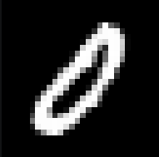
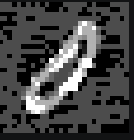
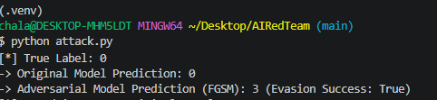
i. Atta….
i.3. Result
Original Image
Adversarial Image
AI prediction

Slide 10
i. Atta….
i.4. Mitigation
Apply adversarial training by including adversarially modified images during model training.

Slide 11
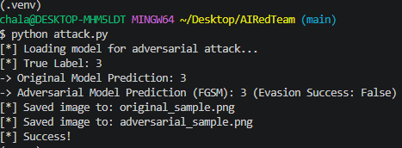

i. Atta….
i.5. Retest
Original Image
Adversarial Image
Predicted result

Slide 12
ii. Attack_2
ii.1. Objective
To determine while the iterative modification on the input image may produce incorrect prediction
ii.2. method
PGD(Project Gradient Descent)
It makes many smaller steps to attack. It is Iterative, multi-step attack.

Slide 13
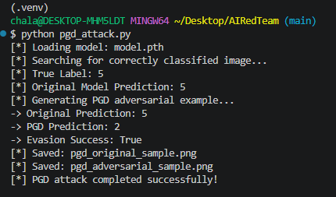
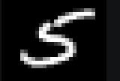

ii. Attack_2
ii.3. Result
Original
Adversarial
Prediction

Slide 14
ii. Attack_2
ii.4. Mitigation
Apply adversarial training by including adversarially modified images during model training.

Slide 15

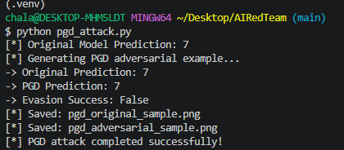
ii. Attack_2
ii.5. Retest
Original
Adversarial
Prediction

Slide 16
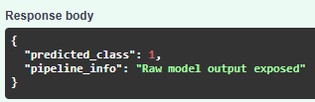
iii. Attack_3
iii.1. Objective
To identify whether the prediction service exposed unnecessary information
iii.2. Observed weakness
Metadata leakage
Metadata leakage

Slide 17
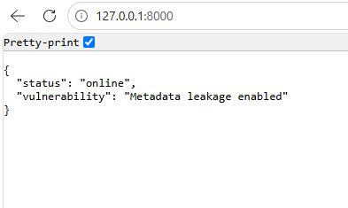
iii. Attack_3
iii.2. Observed weakness
Metadata leakage
Metadata Leakage

Slide 18
iii. Attac….
iii.3. Mitigation
Disclose exposing unnecessary information in API responses.

Slide 19
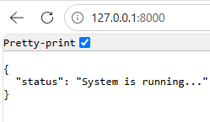

iii. Attac…
iii.4. Retest
Metadata disabled

Slide 20
F. Reproducibility
Clone GitHub repository
Install requirements
Train model
Start Docker container
Run attack scripts
Start API

Slide 21
G. Limitations
Small model
MNIST (small dataset)
Local environment only

Slide 22
H. Conclusion
In this project an image classification AI is built. Original image prediction is tested. Adversarial and metadata leakage attacks were demonstrated. Mitigation to adversarial and data leakage attack was demonstrated successfully. Overall, the size and quality of the dataset are important factors in AI prediction performance.

